Slide 1

PH203: VACUUM SCIENCE AND TECHNOLOGY
Dr. Manoranjan Kar
Associate Professor
Department of Physics
Indian Institute of Technology Patna,
Patna- 800013, INDIA
mano@iitp.ac.in, +91-612-2552013
http://www.iitp.ac.in

Slide 2
VACUUM SCIENCE AND TECHNIQUES
1- Theory of gases
2- Vacuum: Need, generation, measurement, technology components
3- Applications: Thin film deposition, oil industry, nuclear power plant, medical applications, Low temperature etc.
BOOK: 1- Vacuum Technology, A. Roth, North-Holland publisher
2- Handbook of Vacuum Technology, Karl Jousten, WILLEY-VCH

Slide 3
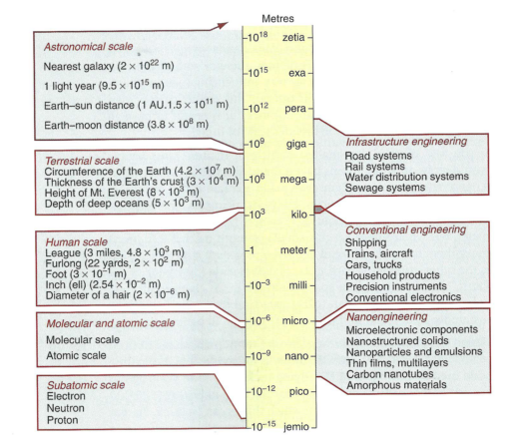

Slide 4

Dr. Manoranjan Kar (mano@iitp.ac.in), Indian Institute of Technology Patna, www.iitp.ac.in
WHAT IS MATHEMATICS?
WHAT IS CHEMISTRY?
WHAT IS PHYSICS?
WHAT IS BIOLOGY?
ARE WE CERTISFY WITH OUR ANSWER? IF YES, HOW TO PASS THE MESSAGE TO OTHERS ?
“para-upkar Swargaya... Narkaya Parapidakam”
LET US PUT OURSELVES A QUESTION NOW....
WHAT IS SCIENCE?
WHAT IS ITS TRANSLATION IN HINDI ?
“SANKHYAN”....... WHAT IS THEN “GYAN” AND “BIGYAN”
Where Engineers and Doctors stand?
Are they part of science?
Why these words are sounds very good and catchy also?

Slide 5
Dr. Manoranjan Kar (mano@iitp.ac.in), Indian Institute of Technology Patna, www.iitp.ac.in
Fundamental Units: There are accepted and non accepted unit systems
Example: Accepted: CGS, MKS, FPS etc
Not accepted: Local units: Bigha, Chain, Ana, Gauni, Tula etc.
The accepted unit is SI (Standard International Unit)
Length, Mass, Time, Electric current, Temperature, Luminous intensity, Amount of substance
Meter(m), Kilogram (kg), Second(s), Ampere(A), Kelvin (K), Candela (Cd), Mole (n)
Physical Quantities: Distinction
SCALAR: A physical quantity called a scalar which has only magnitude. In other words a physical quantity which can completely specified by a number
VECTOR: A physical quantity called a vector which has both magnitude and direction
and, it should obey the vector translation property.
Addition of two vectors:
Multiplication by a scalar
Unit vector
4. Null vector
5. Right handed co-ordinate system
6. Components of a vector

Slide 6
Dr. Manoranjan Kar (mano@iitp.ac.in), Indian Institute of Technology Patna, www.iitp.ac.in
ARE WE READY TO ANSWER ALL THE QUESTION i.e.
CAN WE DISTINGUISH ALL THE PHYSICAL QUANTITIES?
CURRENT, TIME, 5Kg POTATO IN X-AXIS, AND SO ON....
WHAT ARE THESE QUANTITIES?????
SCALAR OR VECTOR????
LET US HAVE ANOTHER DEFINITION.....
PSEUDO VECTOR/ PSEUDO SCALAR: A physical quantity which has both magnitude and direction, but does not follow the vector transformation rule.
This has put us to think what is formulation and how it differ from physics and, how to learn it?
LET US HAVE A FEW PRACTICAL EXAMPLES: WHAT IS THE COLOUR OF BIRD?????
LET US THINK: Geocentric law .....

Slide 7
Dr. Manoranjan Kar (mano@iitp.ac.in), Indian Institute of Technology Patna, www.iitp.ac.in
So what is then physics, its mathematics or something else
CAN WE REPRESENT THE PHYSICAL QUANTITY IN ANY OTHER WAY ????
FOR EXAMPLE: MATRIX
THINK ANY OTHER WAY, IT COMPEL US TO THINK WHAT IS PHYSICS

Slide 8
FORMULATION IN PHYSICS
Classical Mechanics
M, v
M
0
Quantum Mechanics
M, v
v
0
c
Statistical Mechanics
M, v
Special Theory of Relativity
M, c
c
There are four fundamental forces
1: Strong Forces which holds protons and neutrons together in the atomic nucleus. More than 100 times stronger than electric forces.
2: Electromagnetic force : The name electro-magnet comes as electricity generates magnetic field but vice versa is not true.
3: The weak forces which account for certain kinds of radioactive decay. They are not only of short range but they are far weaker than electromagnetic ones to begin with.
4: Gravitational force between any two bodies having mass (M)

Slide 9
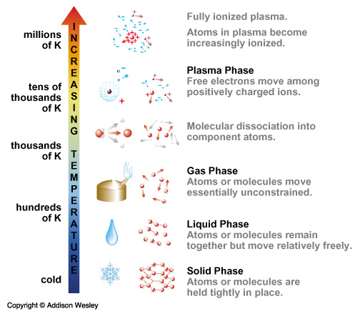
Dr. Manoranjan Kar (mano@iitp.ac.in), Indian Institute of Technology Patna, www.iitp.ac.in

Slide 10
Measurement of Physical Parameters
Parameter measurement
Sensor/
Actuator
Conditioning/
transmission
Indicator/
Recorder
Transducer
Error/
uncertainty
Accuracy: Accuracy is the closeness of agreement between a measured value and a true or accepted value. Measurement error is the amount of inaccuracy.
Precision: Precision is a measure of how well a result can be determined (without reference to a theoretical or true value). It is the degree of consistency and agreement among independent measurements of the same quantity; also the reliability or reproducibility of the result.
The uncertainty estimate associated with a measurement should account for both the accuracy and precision of the measurement.

Slide 11
Relative Uncertainty = | uncertainty /measured quantity|
Relative Error = |(measured value − expected value)/ expected value|
Random Errors:
Random errors are statistical fluctuations (in either direction) in the measured data due
to the precision limitations of the measurement device. Random errors can be evaluated
through statistical analysis and can be reduced by averaging over a large number of
observations.
Systematic Errors:
Systematic errors are reproducible inaccuracies that are consistently in the same
direction. These errors are difficult to detect and cannot be analyzed statistically. If a
systematic error is identified when calibrating against a standard, applying a correction or correction factor to compensate for the effect can reduce the bias. Unlike random errors, systematic errors cannot be detected or reduced by increasing the number of observations.

Slide 12
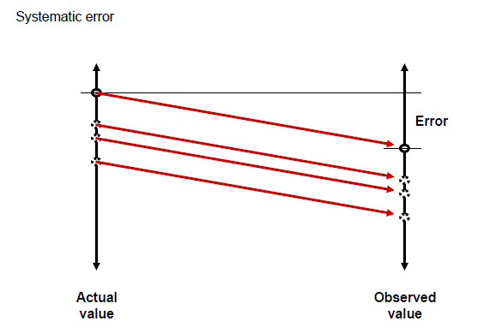
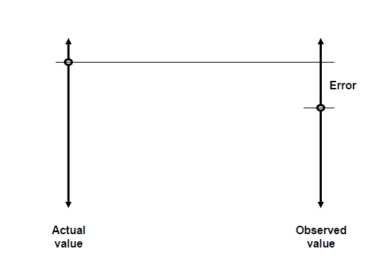
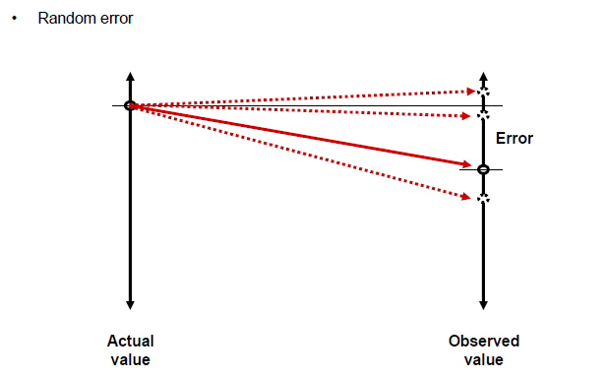

Slide 13
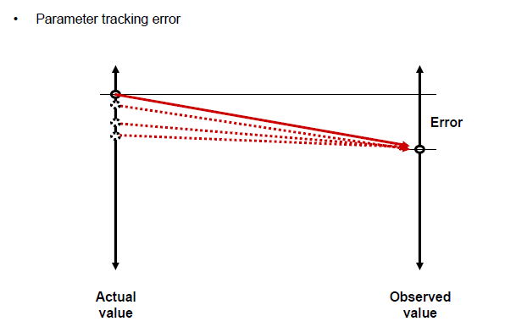
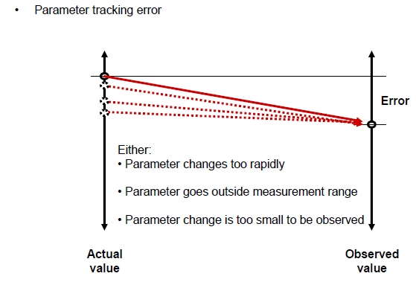

Slide 14
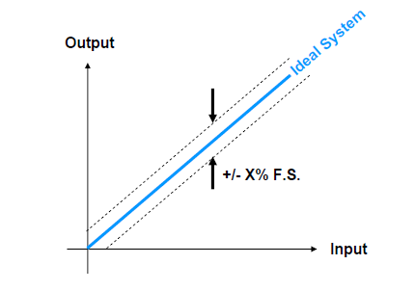
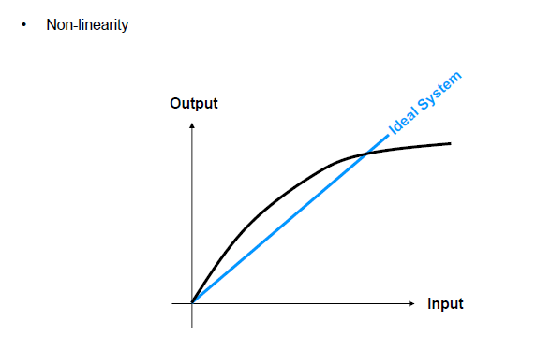
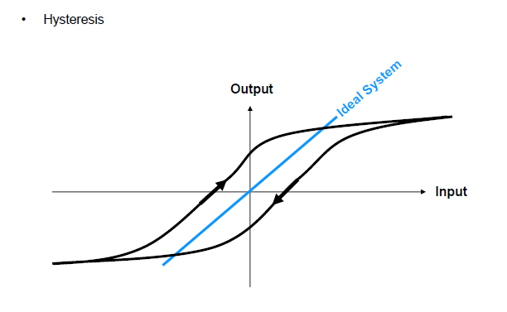
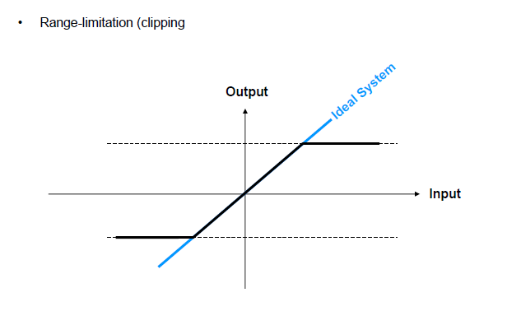
Measurement error/uncertainty characteristic

Slide 15
Parameter measurement
Sensor/
Actuator
Conditioning/
transmission
Indicator/
Recorder
Transducer
Error/
uncertainty
Non-linearity hysteresis
Noise

Slide 16
Incomplete definition (may be systematic or random): Length of thread (stretching by two people is different
Failure to account for a factor (usually systematic): Ignore air resistance while measuring acceleration of free fall
Environmental factors (systematic or random): Drift, vibration, change in temperature etc.
Calibration (systematic)
Zero offset (systematic)
Physical variations (random)
Parallax (systematic or random)
Instrument drift (systematic)
Lag time and hysteresis (systematic)
PROGATION OF ERROR
Δf(x,y,….) = |df /dx|δx + |df/dy |δx+…

Slide 17
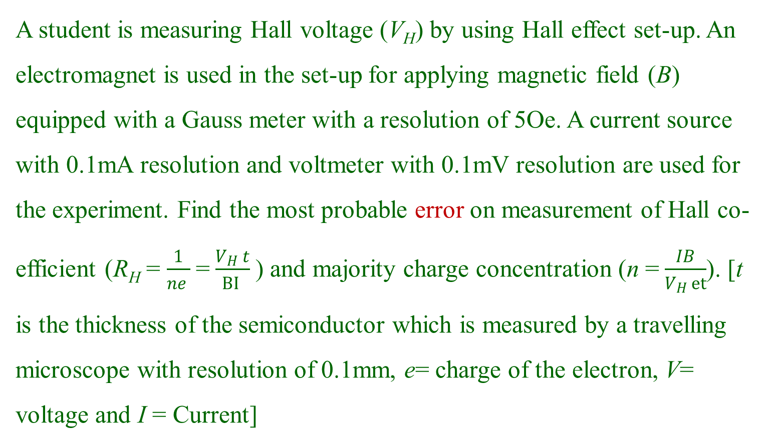
A student is measuring Hall voltage (V_{H}) by using Hall effect set-up. An electromagnet is used in the set-up for applying magnetic field (B) equipped with a Gauss meter with a resolution of 5Oe. A current source with 0.1mA resolution and voltmeter with 0.1mV resolution are used for the experiment. Find the most probable error on measurement of Hall co-efficient (R_{H} =$\frac{1}{ne }$=$\frac{V_{H} t}{BI }$) and majority charge concentration (n =$\frac{IB}{V_{H }et}$). [t is the thickness of the semiconductor which is measured by a travelling microscope with resolution of 0.1mm, e= charge of the electron, V= voltage and I = Current]

Slide 18
Why is there Air ?
Appropriate vacuum is critical to most semiconductor fabrication processes
Understand the hardware
Understand how it works as a system
If you don’t know how it works you can’t use it intelligently
In many real cases, what you do with or to a vacuum systems
has just as much effect on performance as the hardware you
have

Slide 19
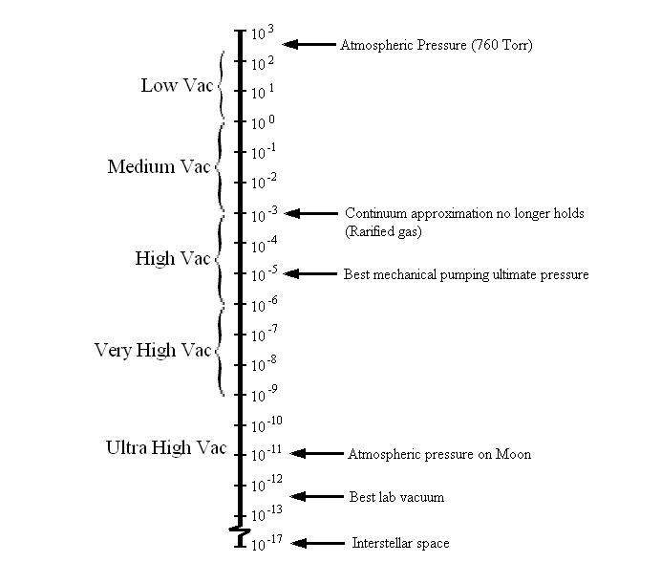
What is a vacuum?
Any gas at sub-atmospheric pressure
Vacuum is really the absence of gas
Vacuum is not absolute, but a continuous range of conditions
15 orders of magnitude in common usage
Wide variety of phenomena
Vacuum Technology
Moving and removing gases

Slide 20
Why vacuum technique ?
1- Holding the plastic or rubber cup
2- Holding objects on the table
3- Lifting the objects
4- Vacuum cleaner
5- pneumatic transport systems
6- pneumatic trains
7- Laboratory and chemical industry
8- Metallurgy industry
9- Packing of food
10- Freeze drying
11- Thermal and electrical insulation
12- vacuum microbalance
13- Modern equipment: X-Ray tube, transmission electron microscopy, photo cells etc.
14- Dewar flasks
15- Tube light, CFl etc.
16- Nuclear power plant,
17- Semiconductor industry
18- vacuum seal etc....

Slide 21
How/Why do we use Vacuum?
Force (P) (Suction)
Transport Medium ( Q ) Throughput
Chemical Vapor Deposition
To “outgas” solids and liquids
Low Density Molecular Space ( MFP (Mean Free Path, n )
Thermal Insulation
Plasmas
Molecular Transport
Extend Mean Free Path
Reduce Chemical Reactions
Create/Maintain a clean surface ( Flux)
And so on where we do not required air

Slide 22
VACUUM
Natural Vacuum
Artificial Vacuum
1958: Definition of vacuum: Space filled with gas at pressure below atmospheric
Density of molecules: < 2.5 x 10¹⁹ molecules/cm³.
Molecular Density, Meen free path and time to form a monolayer

Slide 23
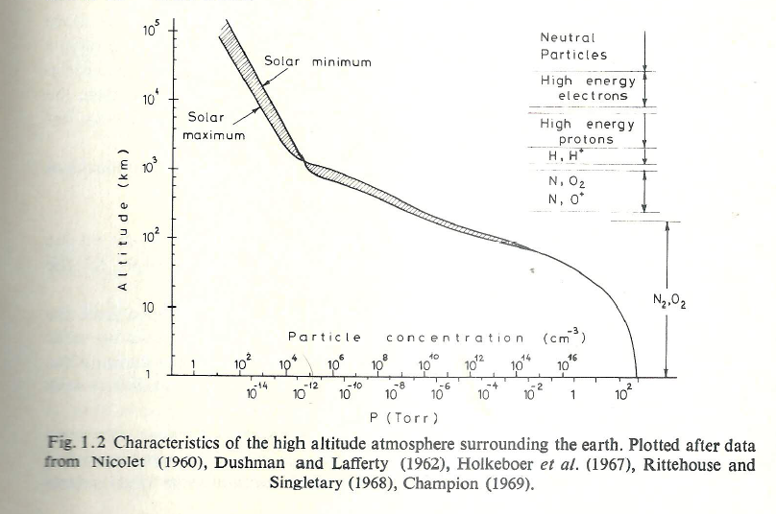

Slide 24
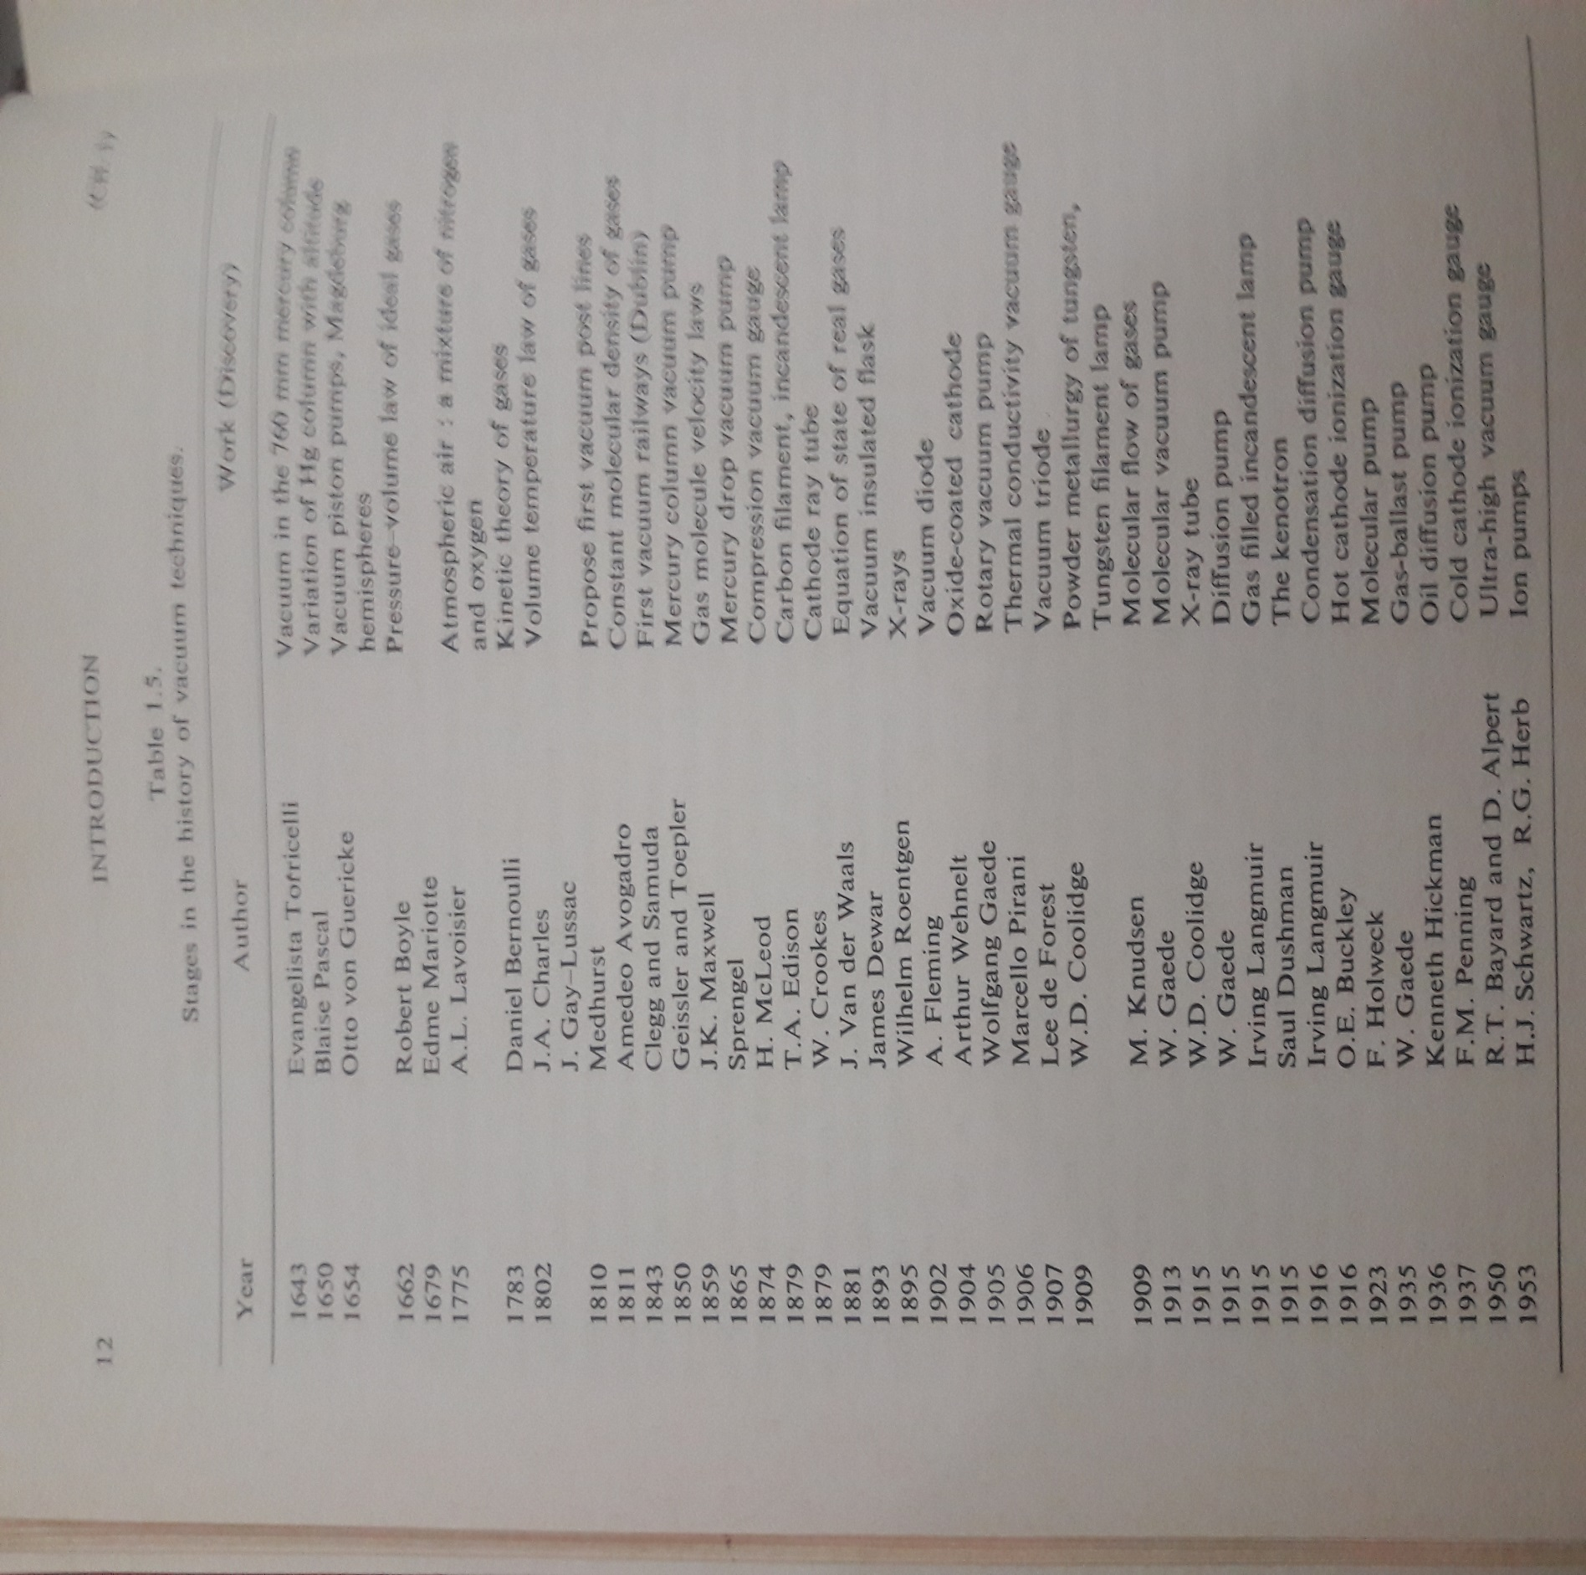

Slide 25
Why vacuum technique ?
1- Holding the plastic or rubber cup
2- Holding objects on the table
3- Lifting the objects
4- Vacuum cleaner
5- pneumatic transport systems
6- pneumatic trains
7- Laboratory and chemical industry
8- Metallurgy industry
9- Packing of food
10- Freeze drying
11- Thermal and electrical insulation
12- vacuum microbalance
13- Modern equipment: X-Ray tube, transmission electron microscopy, photo cells etc.
14- Dewar flasks
15- Tube light, CFl etc.
16- Nuclear power plant,
17- Semiconductor industry
18- vacuum seal etc....

Slide 26
What is a vacuum?
What is a vacuum?
Any gas at sub-atmospheric pressure
Vacuum is really the absence of gas
Vacuum is not absolute, but a continuous range of conditions
15 orders of magnitude in common usage
Wide variety of phenomena
Vacuum Technology
Moving and removing gases
The number of gas molecules is larger compare to that of covering the surface
The gas molecules are located on the surface
Meen free path is equal or greater than the dimention of the chamber
The time taken to form the monolayer is equal or longer than the usual time for laboratory measurement, clean surface

Slide 27
Vacuum pumping is based on one or more of the following principles:
Compression-Expansion of the gas: Ex- Piston pumps, Liquid column or Liquid ring pumps, Roots pumps
Drag by viscosity effects: Ex-Vapor ejector pumps
Drag by diffusion effects: Vapor diffusion pumps
Molecular Drag Pump: Molecular Pumps
Ionization Effects: Ion Pumps
Physical or Chemical Sorption: Sorption pumps, Cryopumps & gettering processes
Parameters
Lowest pressure ( Which can achieved by a pump at its inlet)
The pressure range (Pressure Range in which the pumping speed can be considered useful)
The pumping speed
The exhaust pressure
Selectivity of the pump
Composition of the residual gas.

